Slide 1
Song Dynasty (宋朝)
A critical review and comparison
A presentation by Alexander Maxa (李泽)

Slide 2
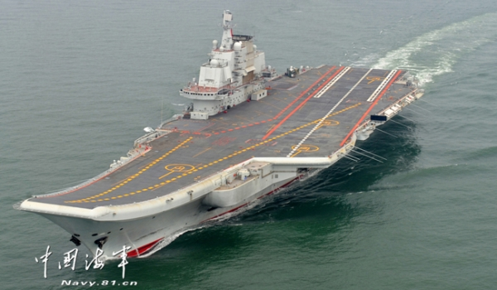
People´s Liberation Army´s Navy (PLAN)
In 2012 China commissioned its first aircraft carrier (self-strengthening, protect its territory) which was named “Liaoning”:

Slide 3
960 - 1279
The successful and powerful military general Zhao Kuangyin (趙匡胤, 927 – 976) who fought against the Khitan people forced the emperor of the Later Zhou (后周) to resign from the throne in 960.
Afterwards he named his dynasty after the prefecture which he governed before: Song.

Slide 4
Furthermore, he declared Kaifeng (开封) to be his capital and renamed himself emperor Taizu (太祖).
Emperor Taizu implemented a government which was totally based on bureaucracy and limited the power of military leaders by having them retired in 961.

Slide 5
Taizu (太祖)

Slide 6
In order to control the armed forces further, he subordinated the whole military apparatus under a civil administration.
The control of the military apparatus was of uttermost importance for the emperor, because as a usurper of the throne himself he knew very well how dangerous the armed forces could be under a charismatic leader.
In fact, it was the last time in Chinese history that the throne was usurped

Slide 7
Emperor Taizu´s military reform did not lead to a downsizing of the armed forced, but to an increasing number of soldiers.
During the 970´s, the Chinese military counted 378,000 soldiers.
His successor, emperor Taizong (太宗, 976 – 997) increased the armed forces to a total manpower of 660,000 soldiers.

Slide 8
Emperor Taizong of Song (太宗, 976 – 997)

Slide 9
Within a few years, the emperors of the Song and their military forces were able to reunite almost the whole Chinese territory.
Starting with Sichuan which was recaptured in 965, the emperors of Song were further able to regain the control over the Southern coastal regions in 971.

Slide 10
Moreover, the Song defeated Wu-Yue at the Yangtze delta in 979 as well as the small state of the Northern Han in today’s Shanxi province.
All in all, the Song governed a territory of 3 million square kilometers which was much smaller than the Tang Empire.

Slide 12
Around 16 prefectures of the former Tang Empire were occupied by the Kithan in Northern China.
Emperor Taizong who ambitiously tried to recapture the Northern prefectures was defeated by the Kithan in 986.
As a consequence of Taizu´s military reform and although (regarding to the fact that) the Song government employed more soldiers, their military apparatus remained weak in strategic important fields.

Slide 13
As a result of their military weakness, the Song Emperors were forced to sign unfair (unequal) treaties not only with the Kithan in the north, but with many other kingdoms (e.g. Liao).
The annual cessions in the amount of 100,000 silver coins and 200,000 bales of silver in order to buy peace ruined the Song financially.

Slide 14
The gentry society
During the later years of the Song, they formed a land society which consisted of gentry.
These were officers and their relatives (family boundaries) who became rich and powerful landlords who could oppose the central government (Center vs. Periphery).
The gentry were well educated, had their own culture and enjoyed fine arts, such as literature (especially poems), paintings and calligraphy.
Furthermore, they were known for their humanistic universalism.

Slide 15
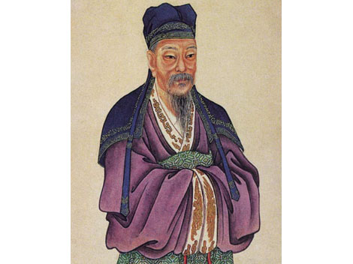
Ouyang xiu (欧阳修, 1007 - 1072)
The critical all-rounder was not only a successful Chinese statesman, but also historian, essayist, calligrapher and poet of the Song Dynasty.

Slide 16
Deep in Spring, the Rain's Passed (Picking Mulberries) Deep in spring, the rain's passed- West Lake is good. A hundred grasses vie in beauty, Confusion of butterflies, clamour of bees, The clear day hurries the blossom to burst forth in the warmth.
Oars in lilies, a painted barge moving without haste. I think I see a band of sprites- Light reflected in the ripples, The high wind carries music over the broad water.
採桑子 春深雨過西湖好， 百卉爭妍， 蝶亂蜂喧， 晴日催花暖欲然。 蘭橈晝舸悠悠去， 疑是神仙。 返照波間， 水闊風高颺管絃。
Ouyang Xiu

Slide 17
Conclusio
The Song governed a much smaller territory than the Tang Emperors.
Moreover, they were more nationalistic than the international Tang with their world empire.
The creative gentry established a new culture with great inventions, such as hydraulic machines

Slide 18
Hydraulic mill for grain (corn, food production)

Slide 19
Conclusio
The Song were interrupted by the Five Dynasties and Ten Kingdoms period
However, they implemented the first permanent standing navy during their military reforms.

Slide 20
非常感谢！

Slide 21
Discussion questions
Imagine that the creative, but nationalistic, gentry of the Song Dynasty would meet the international Tang people:
What could they learn from each other?
Do you think that Chinese history could have been different?

