Slide 1
Xia (Hsia) Dynasty
ca. 2100-1600 BC

Slide 2
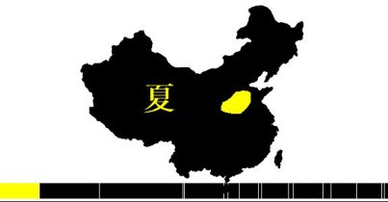
Xia dynasty was real or a myth?
Xia dynasty is the first dynasty of China. It was founded in 2100 BC and ended in 1600 BC.

Slide 3
Huan Di (2698 BC)
Yao
Shun
Yu the Great (2032 — 2025 BC)

Slide 4
Emperors of the Xia dynasty
Order | Chinese name | Pinyin | Reign | Notes
1 | 禹 | Yǔ | 45 | Yu the Great. Stop the problem with floods.
2 | 啟 | Qǐ | 10 | Yu’s son. Established the hereditary system.
3 | 太康 | Tai Kang | 29
4 | 仲康 | Zhòng Kāng | 13
5 | 相 | Xiāng | 28
6 | 少康 | Shào Kāng | 21 | Posthumous child of Xiang. Reportedly founded "ancestor worship," later the official religion of China.
7 | 杼 | Zhù | 17
8 | 槐 | Huái | 26
9 | 芒 | Máng | 18
10 | 泄 | Xiè | 16 | Son of Mang
11 | 不降 | Bù Jiàng | 59
12 | 扃 | Jiōng | 21
13 | 廑 | Jǐn | 21
14 | 孔甲 | Kǒng Jiǎ | 31
15 | 皋 | Gāo | 11
16 | 發 | Fā | 11
17 | 桀 | Jié | 52 | Also Lu Gui (履癸, Lǚ Guǐ). His tyrannical rule brought about the end of the dynasty.

Slide 5
Why Yu became an emperor?
Stop floods;
Measured 9 rivers and 9 chains of mountains;
Divided the country into 9 provinces;
Each province had its own tribute. They pay a tribute according to output.

Slide 6
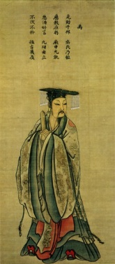
Yu the Great's attempt to stop the floods
Yu was highly trusted by Shun, so Shun appointed him to finish his father’s work, which was to stop the flooding. Yu’s method was different from his father’s: he organized people from different tribes and ordered them to help him build canals in all the major rivers that were flooding and lead the water out to the sea. Yu was dedicated to his work. People praised his perseverance and were inspired, so much so that other tribes joined in the work. Legend says that in the 13 years it took him to successfully complete the work to stop the floods, he never went back to his home village to stop and rest, even though he passed by his house three times.

Slide 7
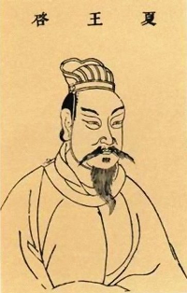
Qi, Gao Yao or Bo Yi?

Slide 8
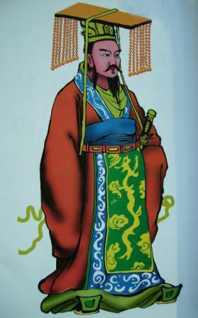
Ancestor veneration is a religion？
He gave acres to feudatory tribes in hereditary tenancy!

Slide 9
The beginning of an end! The 14th emperor Kong Jie was very superstitious. He practiced magic and divination, esteemed spherical spirits. In affairs he was disorderly.
The end on the Xia Dynasty!
Kong Jie (1728–1675 BC) was the 17th and last ruler of the Xia dynasty of China. He is traditionally regarded as a tyrant and oppressor who brought about the collapse of a dynasty.
Around 1600 BC, Jie was defeated by Shang Tang, bringing an end to the Xia Dynasty that lasted about 500 years, and a rise to the new Shang Dynasty.

Slide 10
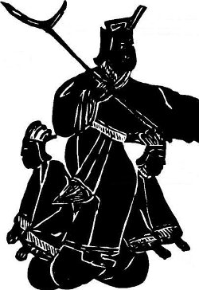
Kong Jie with a halberd, representing oppression, and sitting on two ladies, symbolizing his abuse of power. Rubbing of a relief from a Wu family shrine, Jiaxiang, Shandong.

Slide 11
Conclusions
Xia dynasty is the first dynasty of China. It was founded in 2100 BC and ended in 1600 BC. Historians have have concluded that most of the population of the Xia Dynasty lived in the western Henan Provice and the southern Shanxi Province.
This dynasty transformed China from a primitive society to a class society.
Yu the Great set up the original Xia Dynasty under the system of abdication, which focused on the abilities of a ruler. His son, Qi, succeeded him and from that point forward, the throne was given to members of his families under a system of heredity, thereby rewarding the title of emperor based on family ties. After his death, Qi was succeeded by 15 of his offspring.
At the time the Xia reign was in place, people were mostly farmers and used tools made of bone or stone. Horse breeding, livestock, and the production of crops received much attention and these areas were greatly improved upon. Legend has it that winemaking was also attempted during this period. Although it was likely primitive in nature, vehicular transport did exist; however, not much is known about the types of carriages or rickshaws that were used.

