Slide 1
History of Xi’an: Ancient Treasure
By: Jordan Lieberbaum

Slide 2
Intro to the history museum
Regarding the history of Xi’an, there is no better place to trace its earliest roots than the Shaanxi History Museum.

Slide 3
In the Beginning…
When people today talk about Xi’an they all mention the terracotta soldiers. While these soldiers are indeed marvelous, there is much more to the city’s history.
Xi’an’s city used to be called Chang’an. It was one of the 4 ancient capitals of China and the city had more than 3100 years of history!
Believe it or not, Xi’an’s history doesn’t start with its official dynastic civilization. It starts all the way back in the Neolithic area almost 800,000 years ago.

Slide 4
Early Records
About 800,000 years ago, there lived a human like figure very near present day Xi’an. This creature was named Lantian man, upon the discovery of its skull in 1963.
An ancient Neolithic village named banpo was also traced back to about this time and it is believed that the ancestors of humans in china came from this village and other surrounding tribal towns.
Today there is a museum dedicated to the banpo village and ancient Chinese civilization in Xi’an
Replicas of this lantian man and banpo village are on display in the shaanxi history museum

Slide 7
Keys to ancient civilization
There is one common denominator of all ancient civilizations. That is a river.
In Ancient civilization near Xi’an that river was the yellow river.
The yellow river fueled ancient civilization in Xi’an on the Guangzhong plain in central china.
Since the yellow river at the time was the only reputable water source in northern / central china, it was important for the development of all ancient Chinese civilizations

Slide 9
Ancient artifacts
Due to rich soil from the yellow river area, the people of ancient Xi’an civilization were experts at making tools out of pottery.
Whether it be wine vessels, weapons, or other useful goods, the Neolithic people of Xi’an always had good assets.
Lots of these relics are preserved today in the Shaanxi history museum today

Slide 10
Basic Living
Even in Neolithic times people still were able to craft tools and use them for efficient living.
Some of the most unique artifacts in the history museum were simple clay pots.
Some of these pots were specialized as wine vessels, and others were for tasks such as cooking
It was very interesting to see these pots because it gave me a much better idea of what everyday life was like for the ancient humans in china.

Slide 11
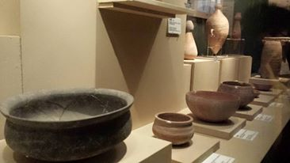

Slide 13
Unique assets
While the pots are very cool, I think the most spectacular things in the museum were the unique items that weren’t for every day use.
Such items included ancient bells, special pottery water pipes, and bones for divination.
Such assets symbolize the start of humans using more sophisticated technology ( sophisticated for that time) in the Neolithic age.
As a scientist I thought that was cool because that is what ultimately separates humans from animals

Slide 14
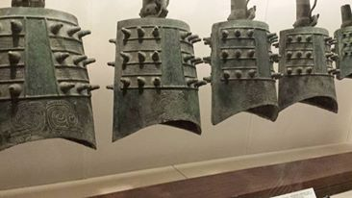

Slide 15
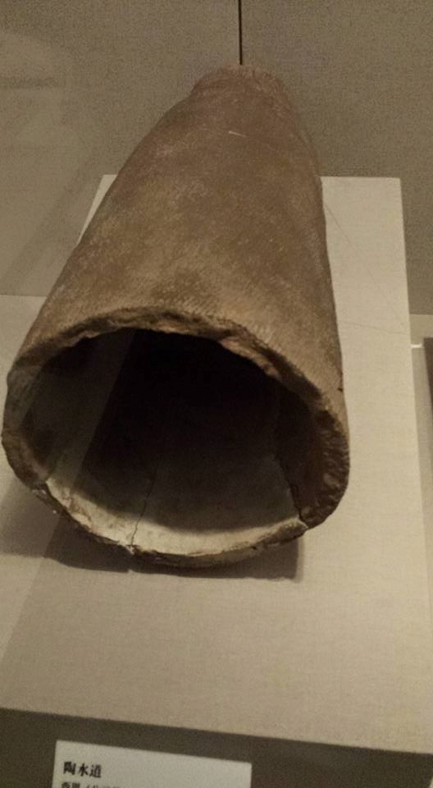

Slide 17
Religion in ancient Xi’an
Almost all ancient civilizations have had religion as a strong foundation of their culture. Ancient Chinese civilization was no exception.
During the Neolithic period in Xi’an, the tribes would have different rituals, worshipping various entities like gods and the land, etc.
Some of the relics used for these rituals are displayed in the museum. It’s truly amazing how many old objects have been excavated in the area of Xi’an.

Slide 18
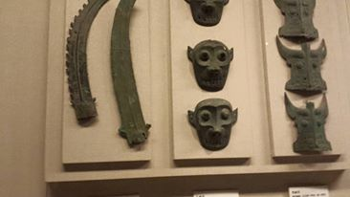

Slide 20
Warrios in Ancient Xi’an
The last very important aspect of ancient civilization is the way of the warrior. In order to survive against competing groups and villages, these ancient people needed a way to defend themselves.
Of course the weaponry back then was very limited but the people found ways to use very simple weapons in order to be effective against assault.
Such weapons included ploughs and crossbows.
As the area evolved in the Neolithic age, many different civilizations formed along the yellow river and the demand for a fighting force was high.

Slide 21
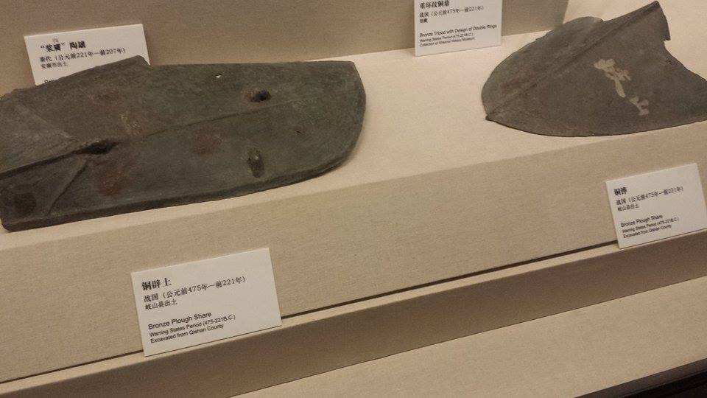

Slide 22
