Slide 1
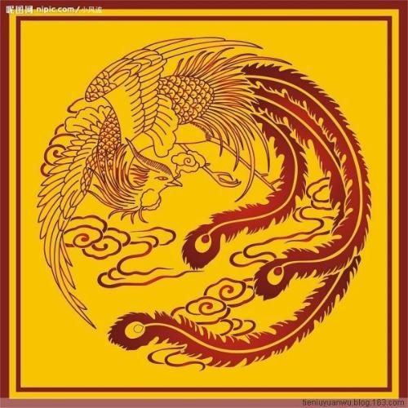
How Cixi became the Strongest Woman of Qing China and the Selection of Imperial Concubines during the Qing Dynasty (1644-1911)
Cixi (1835-1908)

Slide 2
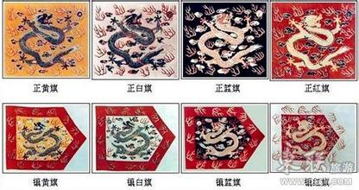
Which girls had to participate to the Selection of Imperial Concubines?
Manchu, Mongolian and Han girls (for the latter ones, only if their parents were high-end army officers).
Only if they originated from families belonging to the Eight Banners.
Girls of those three ethnic groups were obliged to participate at the age of 13 to 17.
The Eight Banners System is composed by:
Pure yellow and bordered yellow
Pure white and bordered white
Pure blue and bordered blue
Pure red and bordered red

Slide 3
24 categories of girls from which the concubines were chosen once every three year
2 reds for Manchu, Mongolian and Han(6 categories)
2 yellow for Manchu, Mongolian and Han (6 categories)
2 blue for Manchu, Mongolian and Han (6 categories)
2 white for Manchu, Mongolian and Han (6 categories)

Slide 4
Selection criteria
The selection contest for imperial concubines may not be seen as a beauty contest.
The girls were first chosen because of their origin and in a second phase for their artistic talents and eventual beauty.
During the Qing Dynasty the rulers were not Han Chinese, but Manchu Chinese, an ethnic minority living in north-eastern China.
Manchu had the reputation to be conservative and self-centered. They wished avoid contact with outsiders. That explains why the high-ranking concubines and wife of the emperor were mostly Manchu. They were most likely to give birth to the successor of the emperor.
Since Manchu are nomadic and needed to keep good relationships with Mongolians, their girls could participate as well. Moreover, Manchurian needed different blood to stimulate fertility.

Slide 5
Step by step
Every girl with participation duty to the selection contest was sent 2 silver coins to hire horse, driver and horse car enabling the journey from home to the Emperors palace, the Forbidden City.
Waiting outside the Gate of Divine Military (神武门).
The Department of Family Registers checked the arrivals and started the first categorizing according to the ethnic group to which the girl belonged. (Manchu, Mongolian, or Han).
In that group the girls where categorized according to the color to which they belonged (yellow, white, blue, red).
Within that color group the girls where categorized according to their age.
Once everybody had a place, the gates opened and the horses drove to 顺贞门. The girls got off whereas driver and family remained inside the car and guided outside the palace. They had to drive a big circle to arrive again at the starting point, where the first eliminated girls waited to go back home.

Slide 6
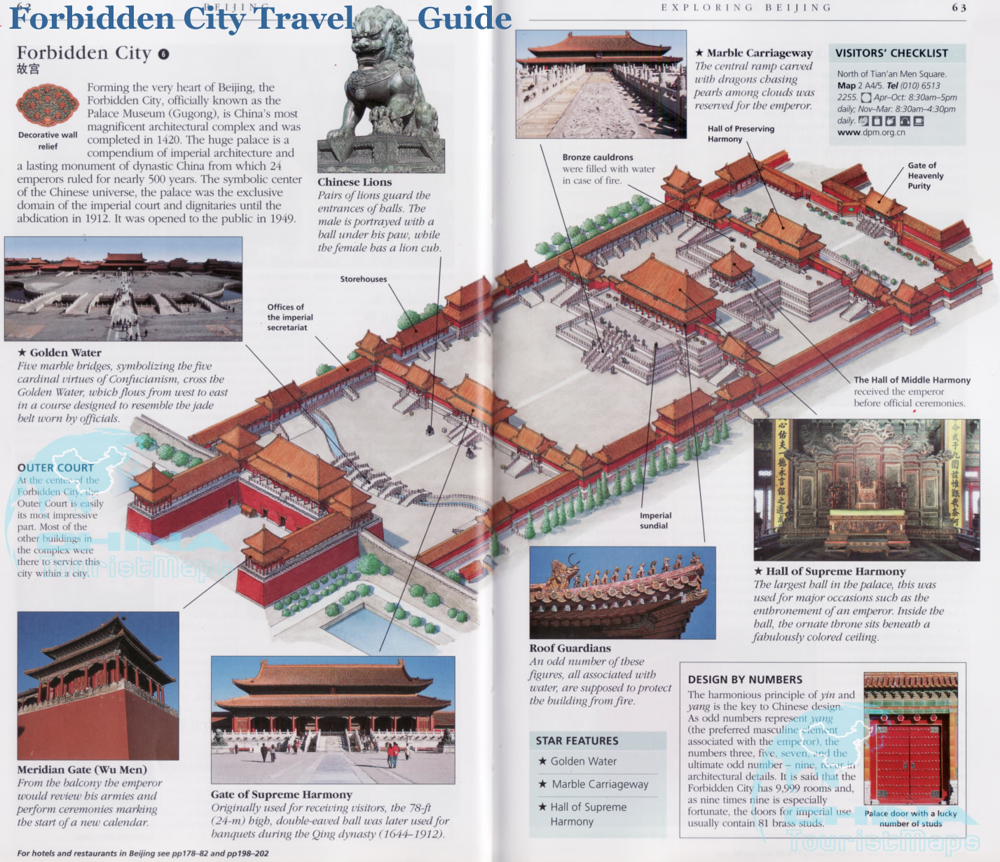

Slide 7
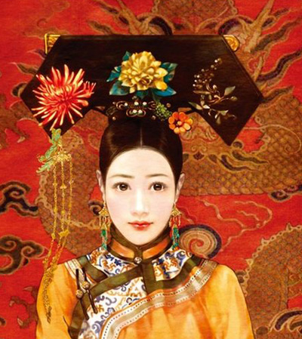
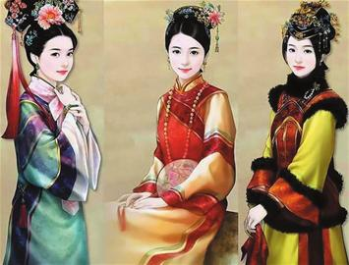
The jury was composed by the emperor himself helped by eunuchs responsible for his health and night life as well as the empress and high-ranking concubines.
Eight ranks in the Imperial Consort Hierarchy:
Empress (皇后): only one in the imperial harem.
Imperial Noble Consort (皇贵妃): only one in the imperial harem.
Noble Consorts (贵妃): only two in the imperial harem.
Consorts (妃): only four in the imperial harem.
Imperial Concubines (嫔): only six in the imperial harem.
Noble Ladies (贵人): unlimited number in the imperial harem.
First Class Female Attendant (常在): unlimited number in the imperial harem.
Choice Lady or Second Class Female Attendant (答应) : unlimited number in the imperial harem.
Elevation in the hierarchy up was possible if the concubine had a very special tide with the emperor or if she gave birth to a son.
Notes:
That gives an idea how cruel it must have been in the Gardens of the Forbidden City. Each girl wished the become the favorite and thus enjoy special privileges but also guarantee she would never been rejected or forgotten.

Slide 8
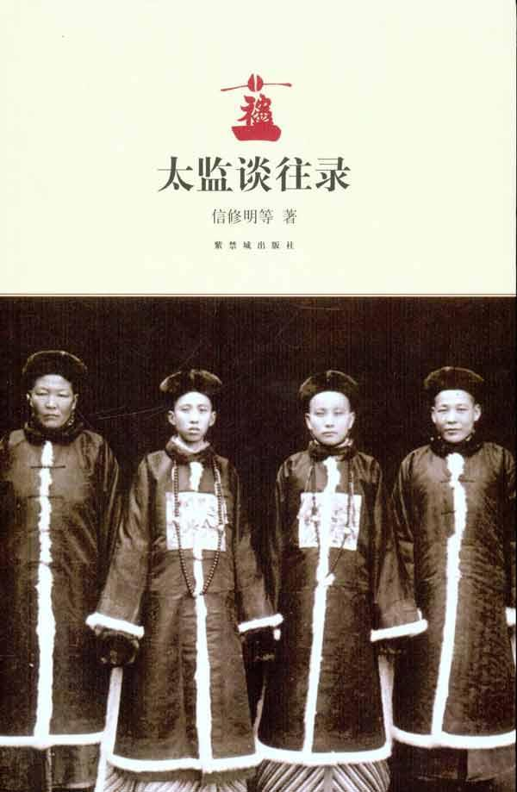
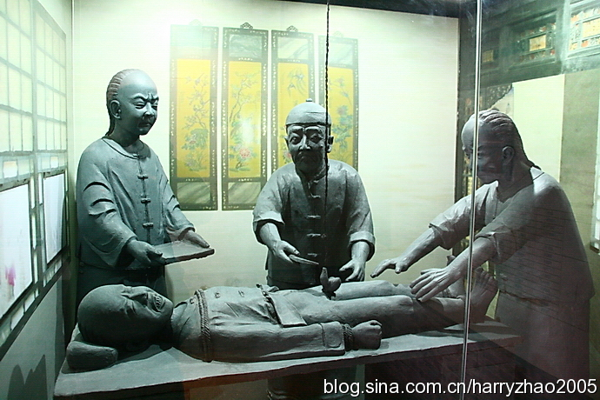
Eunuchs and their responsabilities

Slide 9
The concubines’ responsability
When the emperor was served diner, one of the eunuch in charge of the emperors health presented him a platter wherein laid metal plaques upon which was written the name, origin and rank of the concubines. If the emperor turned one of those plaque with the green side above, it meant he wanted to spend the night with that concubine.
In a second phase the eunuch went back to the gardens where the girls lived. There some of his assistants helped him to prepare the girl:
She got shaved to avoid her hiding hairpins, knives or other dangerous objects suspect to harm the emperor.
She got washed.
Naked and with her hair not attached she got wrapped in different layers of silk.
Finally two eunuchs carried her to one of the emperors sleeping rooms where they put the girl at the foot of the emperors bed where the Heavens Son waited.

Slide 10
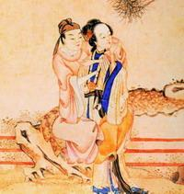
What happened at night?
The two eunuchs leaved the emperors bedroom and waited behind the room. After a while they knocked on the door and if the emperor did not react, they waited five more minutes. In total they would knock three times. If the third time the emperor had still not reacted, they entered the room to invite the Heavens Son to take a break.
The Emperor was not supposed to exhaust his Heavenly Body or waste his Heavenly Essence on which the entire empire relayed.
Before the eunuchs took back the girl, they would ask the emperor a question:
‘’Stay or leave?’’.
If he the emperor answered ‘’leave’’, the girl was send to the Forbidden Cities hospital where acupuncture was applied to induce abortion.
If the emperor answered ‘’stay’, the date and hour was recorded on the plaque to prepare for the emperors eventual posterity.

Slide 11
What happened with the concubines when the emperor passed away?
There are records concerning the imperial concubines belonging to the eight ranks of the hierarchy. Historians know with certainty that emperor Kangxi held the most consorts (79). However it remains difficult to tell exactly how many ladies each emperor has had exactly and how many he personally knew or even spoke with.
When the emperor passed away his harem did not become the successors. His son preferred to choose his own consorts. The ones of his father got ‘released’ or got the new Emperors favor, but in most cases they where pushed aside by the new concubines.
Notes:
They went living in the darker and smaller rooms of the Forbidden City. It was supposedly a terrible boring waiting time until death came.

Slide 12
Imperial Concubines

Slide 13
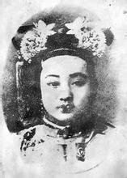
Cixi’s （慈禧）short biography
1835: Cixi was born as the daughter of an ordinary officer from the Manchu Yeherana clan and member of the Bordered Blue Banner.
1851 Cixi participates in the selection for consorts for the new emperor Xianfeng and was chosen to stay.
She is placed in the 6th rank : Noble Lady Lan （兰贵人）.
After Cixi accepts the help of her personal eunuch she seduces Emperor Xianfeng (more with her voice then her beauty) and spends 3 months with him.
854 Cixi is elevated to the 5th rank: Imperial Concubine Yi （懿嫔）.
1855: pregnant.
1856: Cixi gives birth to a son and is elevated to the 4th rank: Consort Yi （懿贵）.
1857: Cixi’s son celebrates his first birthday and since he is the only male heird of Emperor Xianfeng, his mother Cixi is elevated to the 3rd rank: Noble Consort Yi （懿贵妃）.
Notes:
This places Cixi just after the empress and thus becoming the second most important woman in the empeors harem.

Slide 14
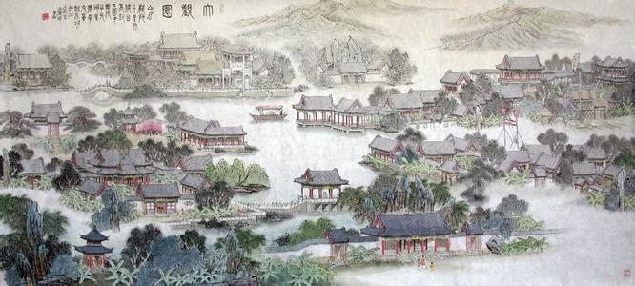
The first turning point in Cixi’s power ascension
Unlike many other women in the imperial harem, Cixi was known for her ability to read and write. This granted her ample opportunities to help the ailing emperor in daily state governing. As a result, Cixi became well-informed about state affairs, and learned the art of state governing from the ailing emperor.
In 1860 the Allied French-Britain Army destroys the Old Summer Palace. The emperor and his court flee to former Chengde. Emperor Xianfeng falls into depression, takes drugs, and starts drinking. He passes away a couple of months later

Slide 15
The first turning point in Cixi’s power ascension
Before the Emperors death he summoned eight of his most prestigious ministers (‘’Eight Regent Ministers’’) to direct and support the future emperor.
He offers to both his wife (Ci’an) and the mother of his son (Cixi) a seal in an attempt to make them harmoniously cooperate and together help the young emperor to grow and mature .
Ci’an and Cixi are both elevated to the title of Empress Dowager:
Ci’an is the East Empress Dowager
Ci’xi is the West Empress Dowager and despite the fact that she is two years older, it is Ci’an who has precedence over her.
Notes:
his son who is only five years old.
That gift has possibly been a way to make both ladies check the power of the Eight Regent Ministers.

Slide 16
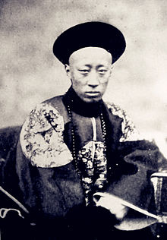
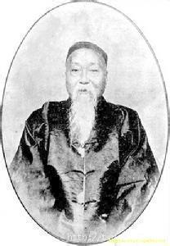
Xianyou Coup (辛酉政變)
Cixi made her first attempts to conspire power in Chengde. That resulted in a cooperation with Ci’an.
Tensions grew among the Eight Regent Ministers and the two empresses dowager. Cixi began gathering the support of talented ministers, soldiers, and others. Among them:
Prince Gong
Prince Chun
While Cixi aligned herself with these princes, a memorial asked for Cixi to “listen to politics behind the curtains’’ （垂帘听政）.
When the Emperor's funeral procession left for Beijing, Cixi took advantage of her alliances with Princes Gong and Chun. She returned to the capital before the rest of the party.
Cixi's early return to Beijing meant that she had more time to plan with Prince Gong and ensure that the power base of the Eight Regent Ministers was divided.
Notes:
Cixi's position as the lower-ranked Empress Dowager had no political power attached. In addition, her son the young emperor was not a political force himself. As a result, it became necessary for her to ally herself with other powerful figures. the late emperor's principal wife, the Empress Dowager Ci'an, Cixi suggested that they become co-reigning Empress Dowagers, with powers exceeding the Eight Regent Ministers, the two had long been close friends since Cixi first came to the harem .^{[7]}
The ministers did not appreciate Cixi's interference in political affairs, and the frequent confrontations left the Empress Dowager Ci'an frustrated. Ci'an often refused to come to court audiences, leaving Empress Dowager Cixi to deal with the ministers alone. The same petition also asked Prince Gong to enter the political arena as a principal "aide to the Emperor."between Sushun and Zaiyuan and Duanhua

Slide 17
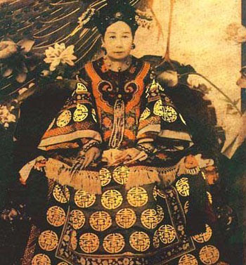
Cixi’s further attempts to consolidate power
As one of the first acts from behind the curtains, Cixi issued two important Imperial Edicts on behalf of the Emperor.
The first stated that the two Empresses Dowager were to be the sole decision makers "without interference“.
The second changed the boy Emperor's era name Qixiang (祺祥: Auspicious) to Tongzhi
(同治: collective stable).
It also seems that their most important role during the regency was merely to apply their seals to edicts, a merely mechanical role in a complex bureaucracy.
Notes:
along with Zaiyuan and Duanhua, two of the principal regents, while Sushun was left to accompany the deceased Emperor's procession
History was re-written and the Regents were dismissed for having carried out incompetent negotiations with the "barbarians" which had caused Xianfeng Emperor to flee to Jehol "greatly against his will," among other charges.^{[7]}

Slide 18
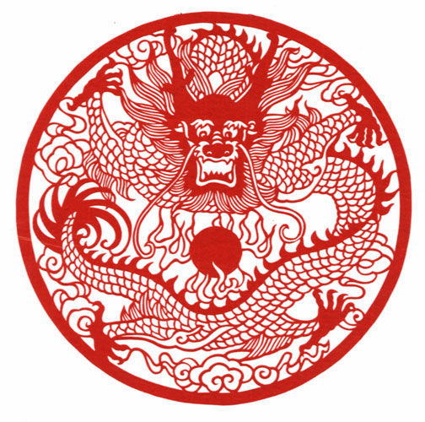
Cleaning Bureaucraty
Cixi's entrance as the absolute power figure in China came at a time of internal chaos and foreign challenges. (Second Opium War, Taiping Rebellion)
Internally, both the national bureaucracy and regional authorities were infested with corruption.
So Cixi entrusted the country's most powerful military unit against the Taiping army into the hands of Han Chinese. Additionally, she appointed Han Chinese officials to become governors of all southern Chinese provinces.

Slide 19
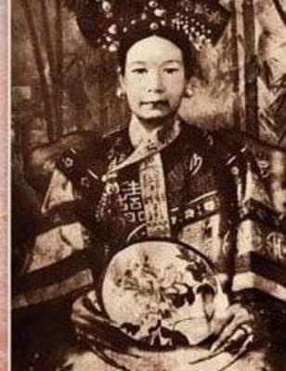
Learning from the West
China's loss in the Second Opium War was a wake-up call for its imperial rulers. China’s military strategies were outdated.
Sensing a threat from foreigners and realizing that China's economy could not compete with the industrial prowess of the West, Cixi decided that China would learn from Western powers.
Failure of China's foreign programs is attributed to Cixi's conservative attitude and old methods of thinking.
Notes:
, both on land and sea, and in terms of weaponry,
for the first time in Imperial Chinese history, and import their knowledge and technology
, and contend that Cixi would learn only so much from the foreigners, provided it did not infringe upon her own power.

Slide 20
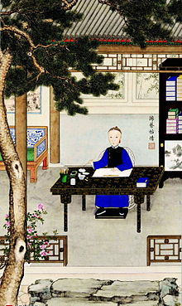
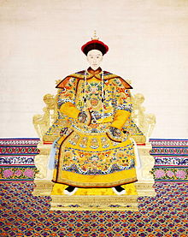
1875: Guangxu Era
On 13 January 1875 Emperor Tongzhi passes away. His young death is probably due to his nightly habits.
Emperor Tongzhi did not leave a male heir behind, a circumstance that created an unprecedented succession crisis in the dynastic line.
The first-born of
Prince Chun and
Cixi's sister was to
become the new
Emperor. The Era
of Guangxu starts.
Notes:
In 1872, the Emperor turned 17. Under the guidance of the Empress Dowager Ci'an, Tongzhi was married to Empress Jiashun. Empress Jiashun's grandfather, Prince Zheng, was one of the eight ministers selected by Xianfeng to guide Tongzhi. He had been Cixi's enemy during the Xinyou Coup, and was ordered to commit suicide after Cixi's victory. As a consequence, tension existed in the relationship between Cixi and Empress Jiashun ever since the beginning, and it was often a source of irritation for Cixi. Moreover, the Empress's zodiac symbol of tiger was perceived as life-threatening by the superstitious Cixi, whose own zodiac symbol was a goat. According to Cixi's belief, it was a warning from God that she would eventually fall prey to the Empress.
The young emperor, who could no longer cope with his grief and loneliness, grew more and more ill-tempered. He began to treat his servants with cruelty, and punished them physically for minor offenses. Under the joined influence of court eunuchs and Zaicheng, eldest son of Prince Gong and Tongzhi's contemporary and best friend, Tongzhi managed to escape the palace in search of pleasure in the unrestricted parts of Beijing. For several evenings the Emperor disguised himself as a commoner and secretly spent the nights in the brothels of Beijing. The Emperor's sexual habits became common talk among court officials and commoners, and there are many records of Tongzhi's escapades. Feeling a grand sense of loss at court and unable to assert his authority, the Emperor returned to his former habits. It was rumored that the Emperor caught syphillis and became visibly ill.
Members of the generation above were considered unfit, as they could not, by definition, be the successor of their nephew. Therefore, the new Emperor had to be from a generation below or the same generation as Tongzhi. or the reign of Glorious Succession. Young Zaitian was taken from his home and for the remainder of his life would be cut completely off from his family. While addressing Ci'an conventionally as Huang O'niang (Empress Mother), Zaitian was forced to address Cixi as Qin Baba (親爸爸; lit. "Biological Dad"), in order to enforce an image that she was the fatherly power figure in the house

Slide 21
Hundred Day’s Reform (戊戌变法)
Even after Guangxu began formal rule, Cixi continued to influence his decisions and actions, despite residing at the Summer Palace.
After taking power, the Guangxu emperor was more reform-minded than the conservative-leaning Empress Dowager Cixi.
Guangxu believed that by learning from constitutional monarchies China would become more powerful politically and economically.
In June 1898, the Guangxu Emperor began the Hundred Day’s Reform (戊戌变法).
Those reforms were too sudden for a neo-Confucian China. And displeased Cixi as it served as a serious check on her power.
The Emperor lost all honors, respect, power, and privileges, including his freedom of movement.
Notes:
which she had ordered Guangxu's father to construct, with the official intention not to intervene in politics
aimed at a series of sweeping changes politically, legally, and socially. For a brief time, after the supposed retirement of the Empress Dowager Cixi, the Guangxu Emperor issued edicts for a massive number of far-reaching modernizing reforms
The reforms, however, were too sudden for a China still under significant neo-Confucian influence, and displeased Cixi as it served as a serious check on her power. Some government and military officials warned Cixi that the ming-shih (reformation bureau) had been geared toward conspiracy. Allegations of treason against the Emperor, as well as suspected Japanese influence within the reform movement, including a suspicious visit from the Japanese Prime Minister, led Empress Dowager Cixi to resume the role of regent and once again take control of the country

Slide 22
Boxer Uprising, Fall of Beijing and cooperation with Allied Army
In 1900, the Boxer Uprising broke out in China. Cixi threw in her support to these anti-foreign bands and declared he war on the European powers.
Due to sabotage in the court itself, the Allied Army was able to march into Beijing and seize the capital.
After the fall of Beijing, the allied forces negotiated a treaty with the Qing dynasty. The Dowager was decided that the terms were generous enough for her to acquiesce and stop the war.
But Cixi wanted the Western powers to set up a government strong enough to suppress further anti-foreign movements, but too weak to act on its own.
Notes:
Included in the terms of the agreement was a guarantee that the China would not have to give up anggt000 y further territories to foreign powers. Many of the Dowager Empress's advisers in the Imperial Court insisted that the war against the foreigners be continued. They recommended that Dong Fuxiang be given responsibility to continue the war effort.
at least after she was assured of her continued reign when the war was concluded.^{[41]}
they supported the continuation of the Qing, rather than allowing it to be overthrown.

Slide 23
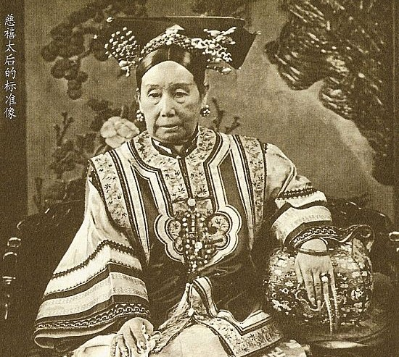
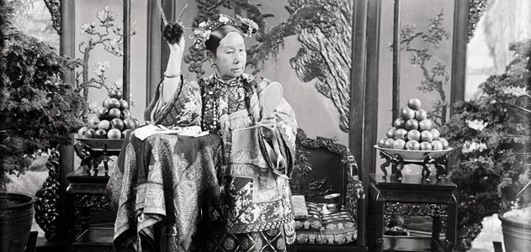
Death of Empress Dowager Cixi and The Last Emperor of China
On 15 November 1908, after having installed Puyi as the new Emperor of the Qing Dynastyon 14 November, Cixi passed away. Her death came only a day after the death of the Guangxu Emperor.

Slide 24
In the end, who was Cixi?
Positive Accounts on Cixi
Negative Accounts on Cixi
Most problematic points in Chinese history happened when Cixi was in "retirement" . Did she came out in order to clean up Emperor Guangxu shoddy administration?
Emperor Guangxu would have plotted to kill his aunt?
Cixi’s opponents among the reformers succeeded in making her a scapegoat for problems beyond her control?
Cixi would not have been more ruthless than other rulers?
There would be a great deal of sexism and Orientalism in the accepted negative accounts?
…
Cixi would have poisoned pregnant concubines of Emperor Xianfeng?
Cixi would have known about her sons nightly habits but did not stop him in an attempt to enhance his death?
Cixi would have caused the death of Emperor Guanxu by arsenic poisoning?
Weren’t the lavish palaces, gardens and lakes built by Cixi hugely extravagant at a time when China was verging on bankruptcy?
…
Notes:
Due to the bias of anti-imperialist nationalists and her enemies, the dominant historical view of the Empress Dowager Cixi was that of a devious despot who contributed in no small part to China's slide into corruption, anarchy, and revolution. During Cixi's time, she used her power to accumulate vast quantities of money, bullion, antiques and jewelry, using the revenues of the state as her own. such as when her nephew focused on studying Confucian texts instead of building up the army at the same time that Japan was amassing its navy. When the First Sino-Japanese War became untenable,

Slide 25
In the end who was Cixi?

